Slide 1
ANALYZING USER PREFERENCE
Data Science Project Team X
Nguyễn Ngọc Lâm 20162316
Phan Đình Tường 20164582
Nguyễn Minh Hiếu 20161546
Lê Bảo Khánh 20162135
Lê Xuân Thành 20163711

Slide 2
PROBLEM IN REAL LIFE
A Simple Movie Recommendation System
(We have to consider between: Collaborative Filtering .vs Content Base)

Slide 3
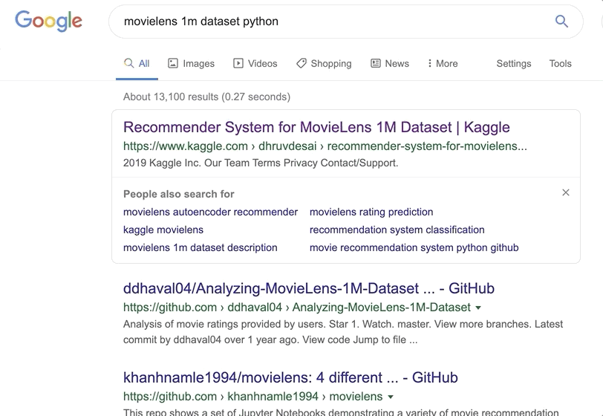
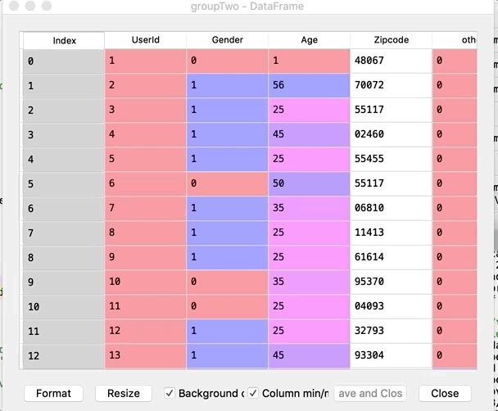
USER DATASET: ML1M LIBRARY 🎉🎉

Slide 4
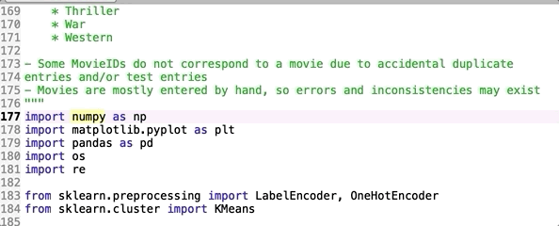
THEORETICAL EXPLAINS!
//TODO
# Preprocess data
Elbow & K-means
Visualize data
Statistical Approach

Slide 5

FIRST, ELBOWS & K-MEANS ALGORITHM 👩‍💻

Slide 6
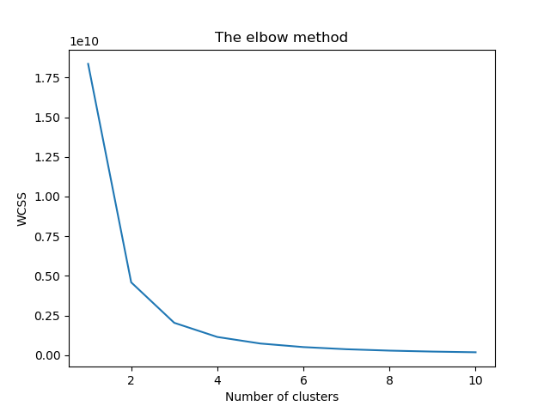
The Elbow method to select K

Slide 7

THEN WE DO SOME VISUALIZATION STUFF

Slide 8
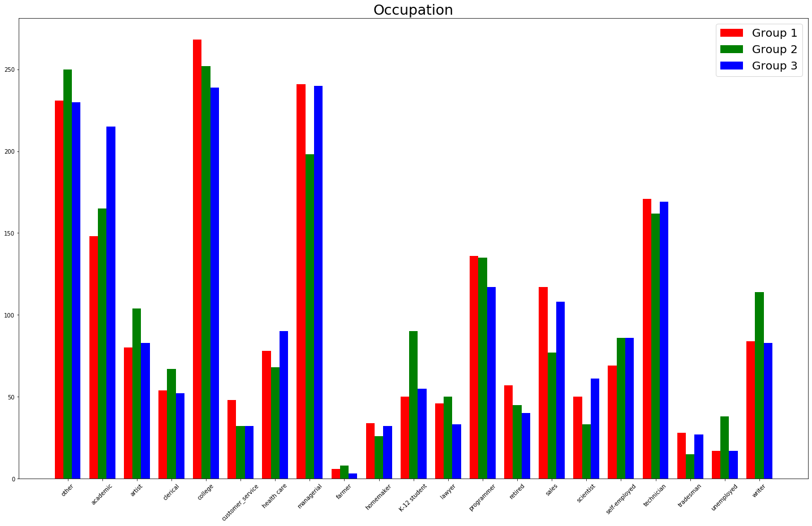
These are what we achieve! 🤓

Slide 9
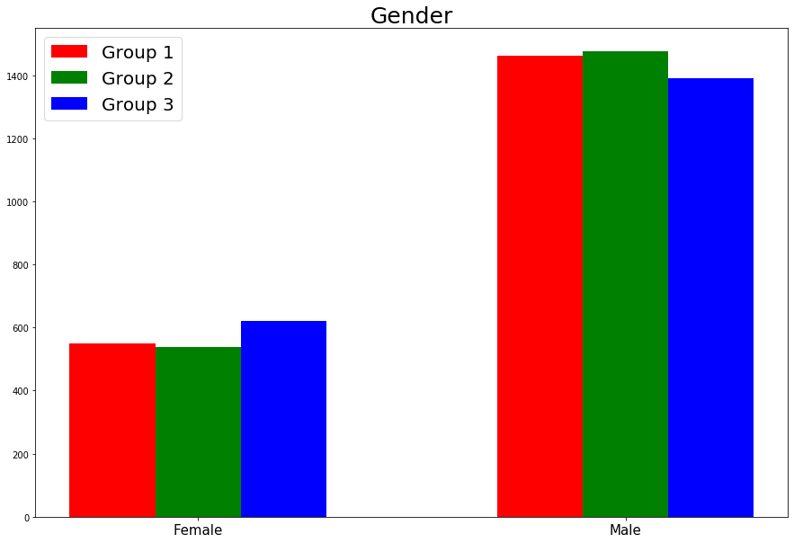
Gender Data

Slide 10
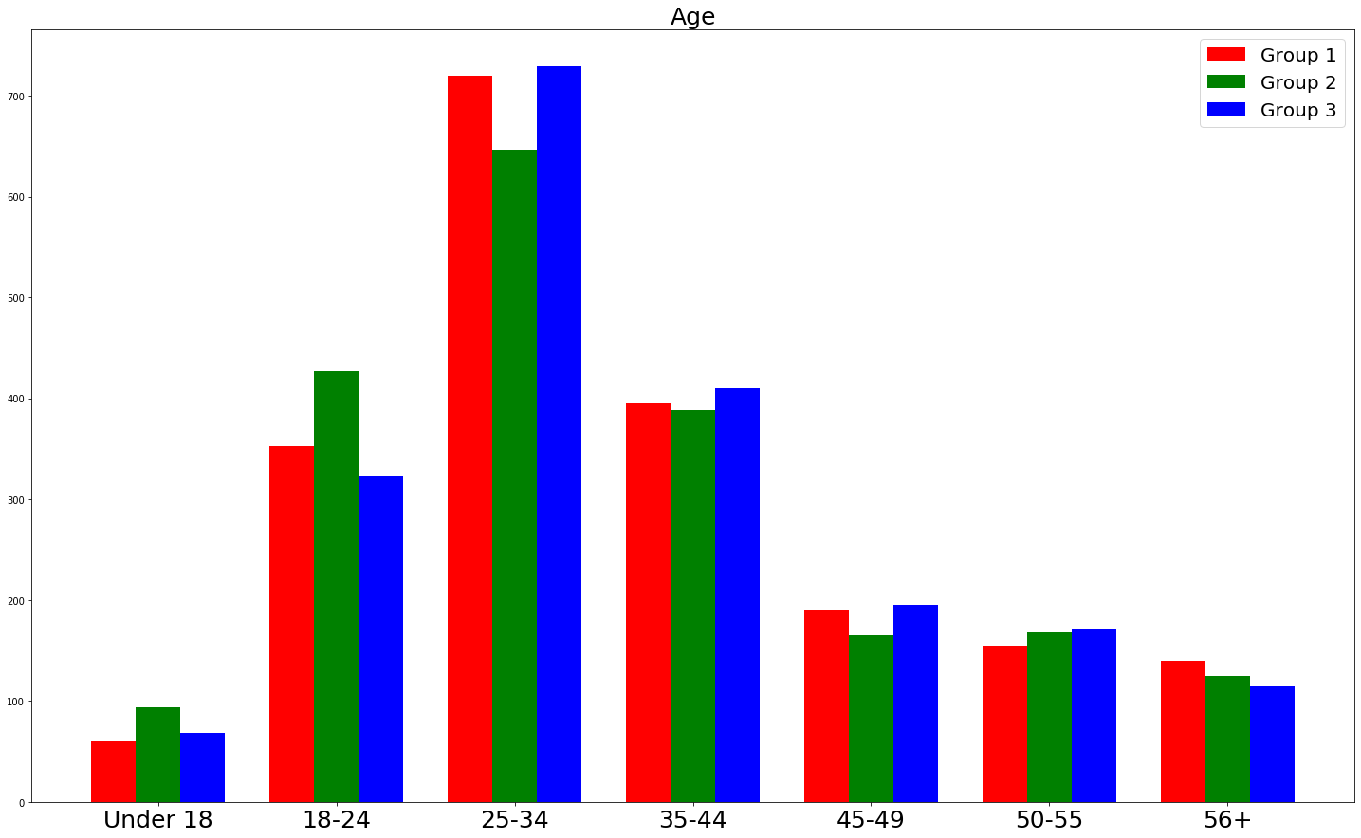
Last but not least, age data!

Slide 11
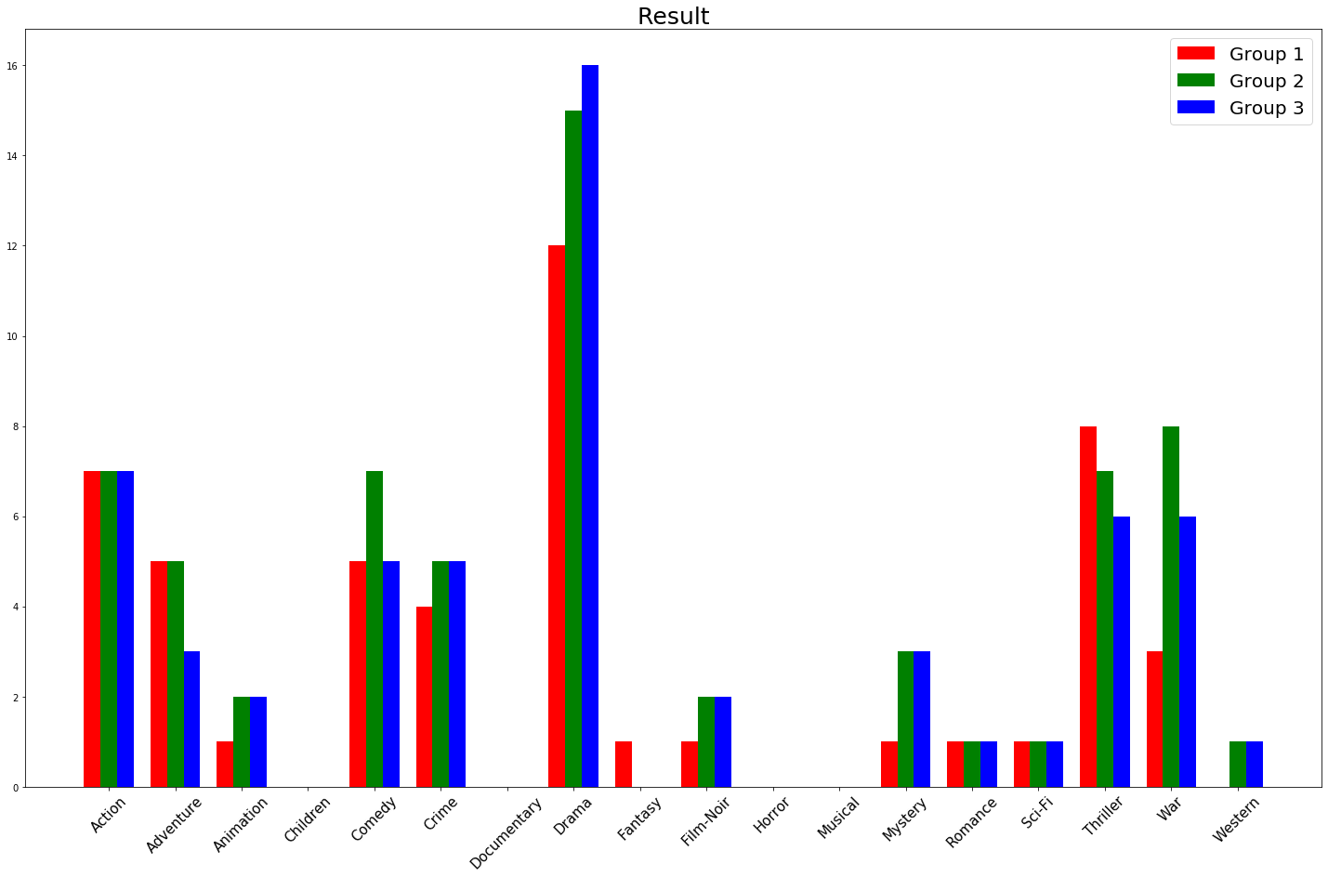

Slide 12
PROS AND CONS, OF COURSE!
PROS
Easy to understand, easy to implement
Relatively simple to implement.
Scales to large data sets.
Guarantees convergence.
CONS
Choosing k manually (based on Elbow)
Scaling with number of dimensions.
Complexity when increasing dimension

Slide 13

Some problem occurs when we choose topic
Youtube not sharing user experience
We have to use generic dataset
Depend on pre-rating of customer (collaborative filtering) nên có vấn đề cold start, ...

Slide 14

BUT we have learnt a lot!
Clustering: What it is, What it does, How it does things, numerous algorithms to does it
K-means: What it is, What it does, How it does things, apply it to get user group
Revision on statistics

Slide 15
What we could improve in the future?
Implement a content-based algorithm. For example,
Consider each observation of a movie is a vector in a multidimensional space.
Calculate cosine of each pair of vectors, put the result into a number of movies * number of movies 2-dimension array
Each column of mentioned array will be list of cosine of each movies to the particular movie represented by that column
The closer the value of cosine is to 1, the closer the movie is to the need-to-find-neighbor movie
Improve this algorithm to better match the preference of user
Using high mean, low standard deviation is very simple.
Genre recommendation is not good enough since a lot of ratings are favourable to drama since it is the dominated genre.

Slide 16
Q&A
Please ask us some question!

